Slide 1

News Network Twitter Analysis
Leon Chen, Maxwell Rankins & Chris Pizani
Salem Othman
COMP 3800-05 Big Data Programming

Slide 2
Overview
Introduction
Objectives
Dataset
Methods
Results
Lessons Learned
Future Work
References

Slide 3
Introduction
Took tweets from news networks to find some specific keywords and phrases that caught the public's eye
Looking for more engagement including likes, replies, and retweets
Used GetOldTweets3 to acquires tweets and replies from specific news profiles
What tweets have a positive and negative reaction
What can news networks do to expand their publicity with tweets?
How can they improve the quality of their tweets?

Slide 4
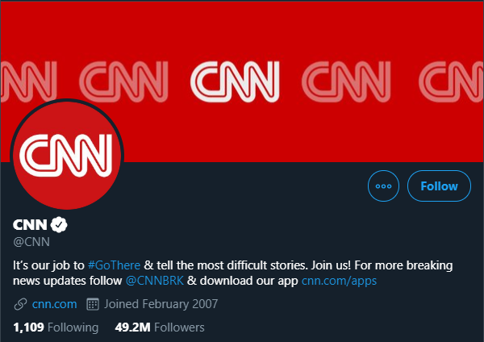
Objectives
Twitter is all about likes, comments, and retweets when spreading a tweet so we are seeing what news accounts have done in the past to get the biggest numbers.
Which news networks are getting the most publicity
To be able to find what keywords give the news networks the most exposure
See what news networks can do in the future to enhance their online presence

Slide 5
Dataset
Gathered Using GetOldTweets3
CSV (Comma Separated Values)
Size of Data ~3.2 MB
Columns Date, User, replies, retweets, favorites, tweet
Number of rows 14194 Rows

Slide 6
Methods
Downloaded the library GetOldTweets3
Scraped For the tweets
Used Colab and imported the needed libraries.
Loaded the csv file into Spark
Centered the Numerical Columns in the DF
Cleaned the tweets
Grouped by each word and took the average of replies, retweets and favorites for each word
Used Word Cloud to visualize the data

Slide 7
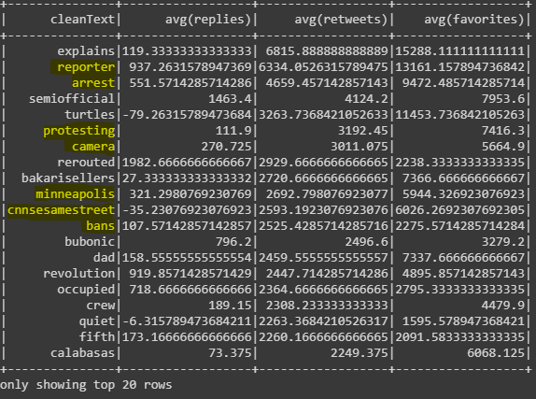
Results
Results from the CNN news network on twitter
Shows the average retweets, favorites, and replies of tweets that include the words in first column
Organized average retweets in descending order

Slide 8
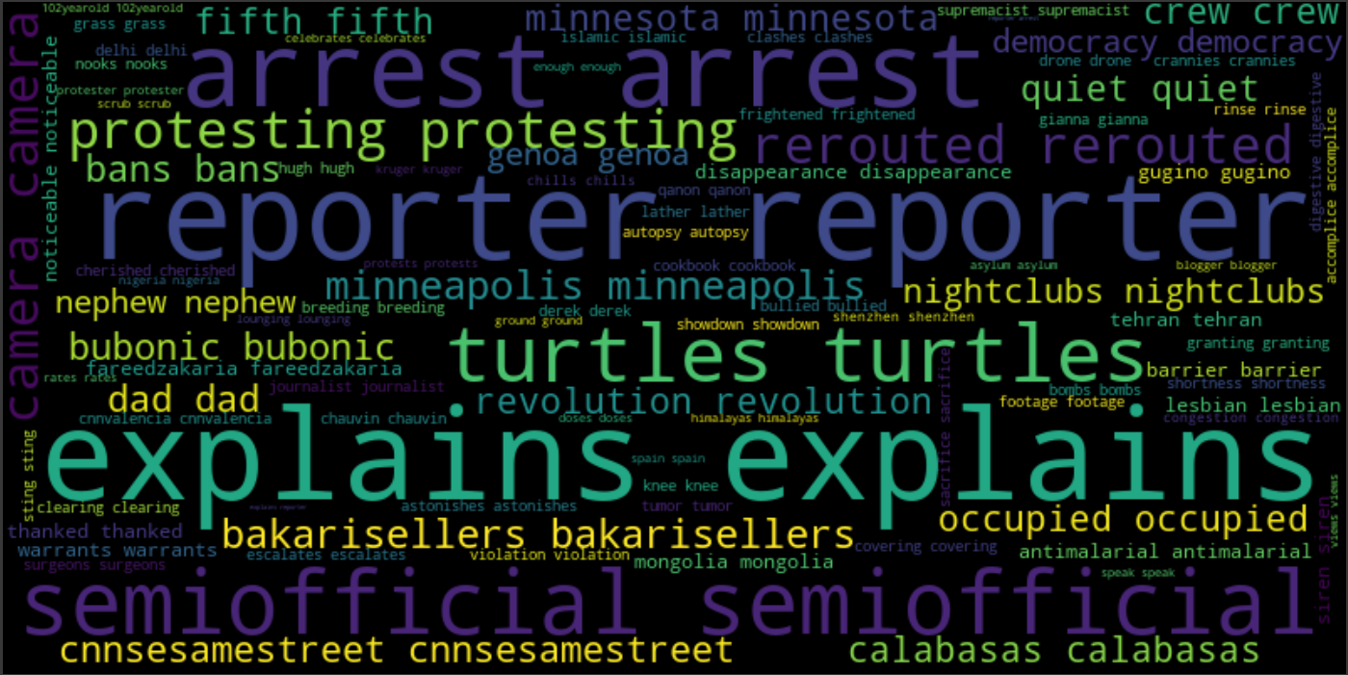
Word Cloud of Findings

Slide 9
Lessons Learned
Developing a proper way to work with data is import
  Cleaning
  Massaging
  Transforming
Big recent events tend to get more interactions on social media
If you want to do an easier project do pick a project that does not requires word processing
  Working with numbers is so much easier.
A Theory that Negative news tend to get more interactions online or it might be cause there are more negative news.

Slide 10
Future Work
Develop a new method of Cleaning the Tweets
  Not parsing phrases
  Remove words that don’t occur N number of times
  Context is important
Scrap More Data For the project
Gather Data for different type of twitter accounts to avoid possible bias in the data.
Maybe possibility great a twitter program that auto generates a tweet from the findings when you give it an article.

Slide 11
References
https://github.com/Mottl/GetOldTweets3#egg=GetOldTweets3
https://pypi.org/project/GetOldTweets3/
https://towardsdatascience.com/how-to-scrape-tweets-from-twitter-59287e20f0f1

